Slide 1
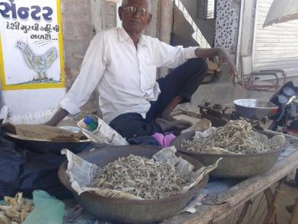
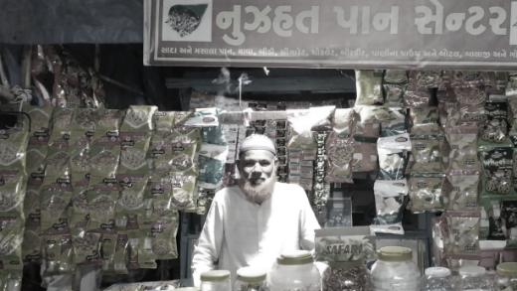
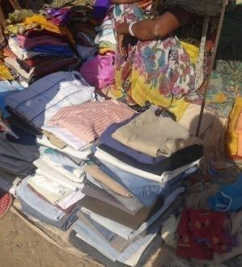
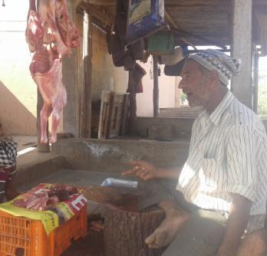
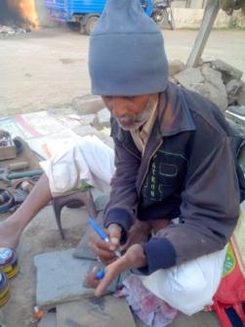
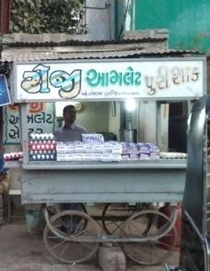
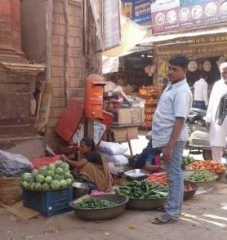
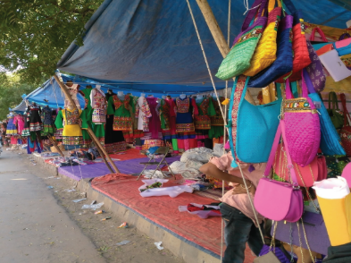
VENDORS’ FORMALISATION & TRAFFIC MANAGEMENT
Pictures’ Source: Students of TISS
Fellow: Aditya Singh | Sub-Fellow: Bhawna Jaimini
Hunnarshala Foundation for Building Technology and Innovations
19th December 2017

Slide 2
Contents
Context and Introduction
Summary of the Work Done
Vision and Objectives
The Study
Methodology
The Proposals
Extension of the Fellowship

Slide 3
CONTEXT AND INTRODUCTION

Slide 4
Introduction
“
A street vendor/hawker is a person who offers goods for sale to the public at large without having a permanent structure/place for his activities. Some street vendors/hawkers are stationary in the sense that they occupy space on pavements or other public/private places while others are mobile in the sense that they move from place to place carrying their wares on push carts or baskets on their heads.
”

Slide 5
Introduction
It is estimated that there are about 10 million vendors in the country.
NSSO (1993-94) estimates the proportion of street vendor population as follows:
Urban Areas: 0.89% of the population
Rural Areas: 0.27% of the population
On an average a vendor earns a meagre Rs 40 to Rs 80 per day.
About to 10% to 20% of vendors’ income goes to bribes and other such levies.
There are studies that have stated that in addition to lack of social and economic security, there are several health related issues that are faced by vendors, which include the following:
Migraine
Hyper-acidity
Hyper-tension
High blood pressure etc.
Source: Sankaran et al; WEIGO Law Pilot Project on the Informal Economy- Street Vendors in India; www.wiego.org; Accessed: 18/12/2016
NASVI; Statistics & the Street Vendors; www.nasvinet.org; Accessed: 18/12/2016

Slide 6
Introduction
Source: NASVI; Statistics & the Street Vendors; www.nasvinet.org; Accessed: 18/12/2016

Slide 7
Introduction
Source: NASVI; Statistics & the Street Vendors; www.nasvinet.org; Accessed: 18/12/2016

Slide 8
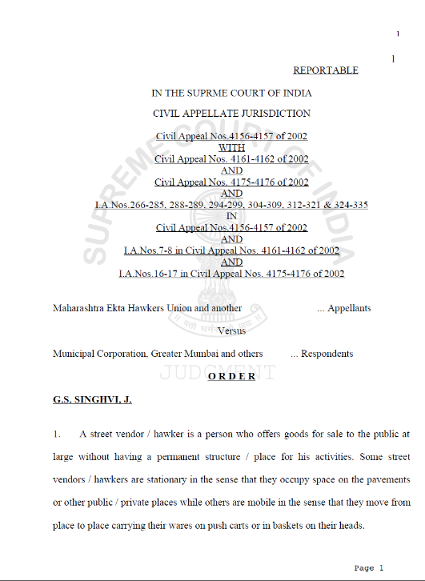
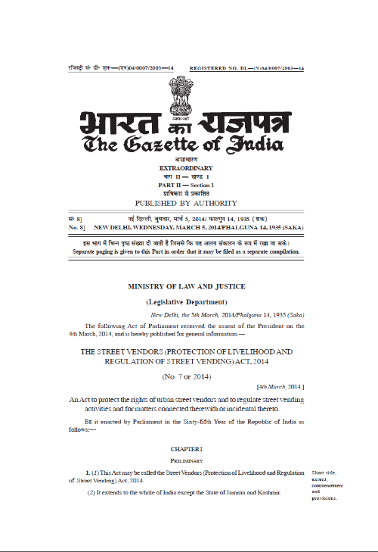
Introduction
Supreme Court Ruling, Sept 2013
SUSV Scheme (Central) for Vendors, Dec 2013
Street Vendors Act, 2014

Slide 9
SUMMARY OF WORK DONE

Slide 10
Recap- Vision and Objectives
VISION
Set up a mechanism for provision of social and economic security to the vendors of Bhuj city by linking them to basic infrastructure and services.
OBJECTIVE
To address the vulnerabilities of the urban street vendors through a multi-pronged approach.

Slide 11
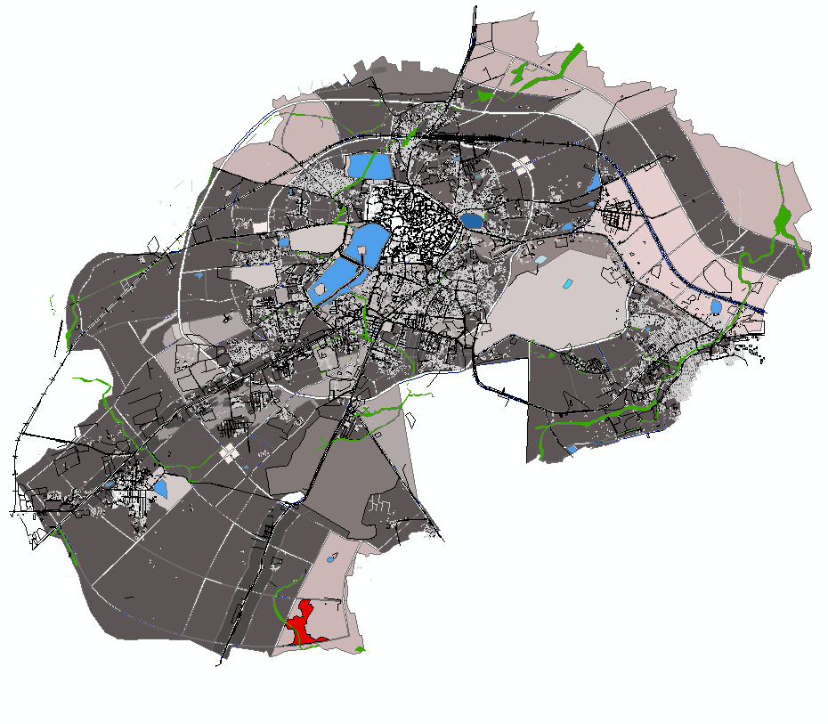
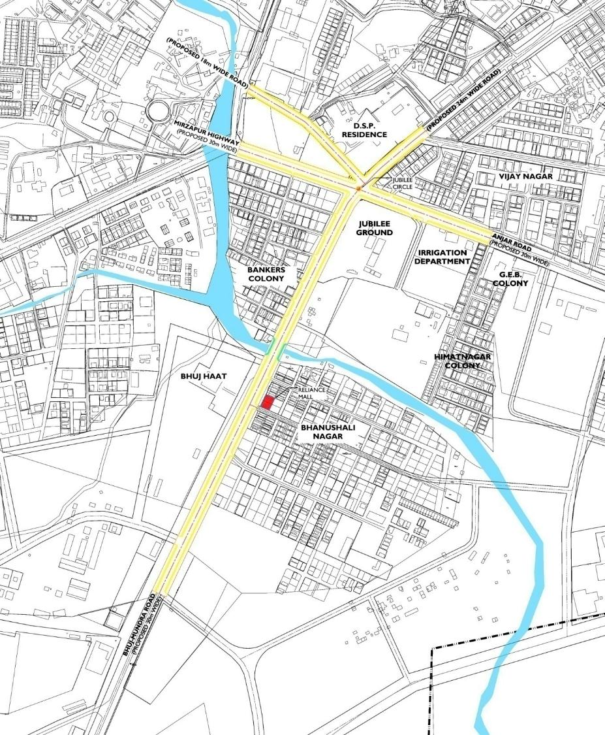
Recap- The Study
KEY PLAN
LOCATION MAP
IDENTIFIED ROADS FOR PROPOSAL

Slide 12
Recap- Methodology
Context Analysis
Vending Profile, Traffic Surveys
Participatory Design Approach
Engaging stakeholders through surveys, focused group discussions, design discussions etc
Mapping
Maps
Land Use Determination
Analysing Available Physical Space
Identifying Stakeholders
Road Sections etc
Assessing Requirements
Finalising Interventions
Vendors

Slide 13
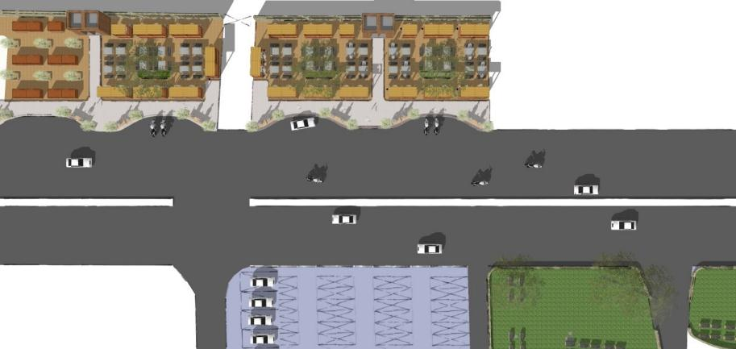
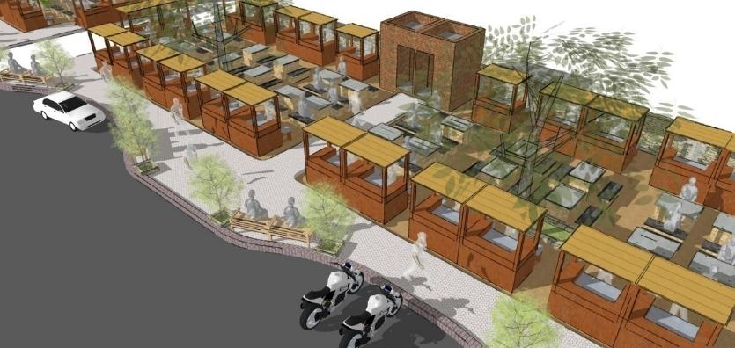
Recap- The Proposals
Organised Vendor Zone with Seating Area
Footpath with Halt Zone
Carriageway
Carriageway
Organised Parking
Service Lane
WORK SO FAR
ROUTE E2 PROPOSED ROAD SECTION
Area statement:
Landscaped Area (Vendors) - 861 sq.m
Paved Areas (Footpath) - 762 sq.m
Green Zone - 448 sq.m
Parking - 453 sq.m
Toilets - 28 sq.m
TOTAL DEVELOPED - 2552 sq.m
Vending spaces provided for:
Vegetables/Fruits - 22
Eatery - 35
Misc. - 10
Parking:
Two-wheeler - 76
Four-wheeler - 09
Auto - 04
VENDOR FORMALISATION: BHUJ HAAT SITE

Slide 14
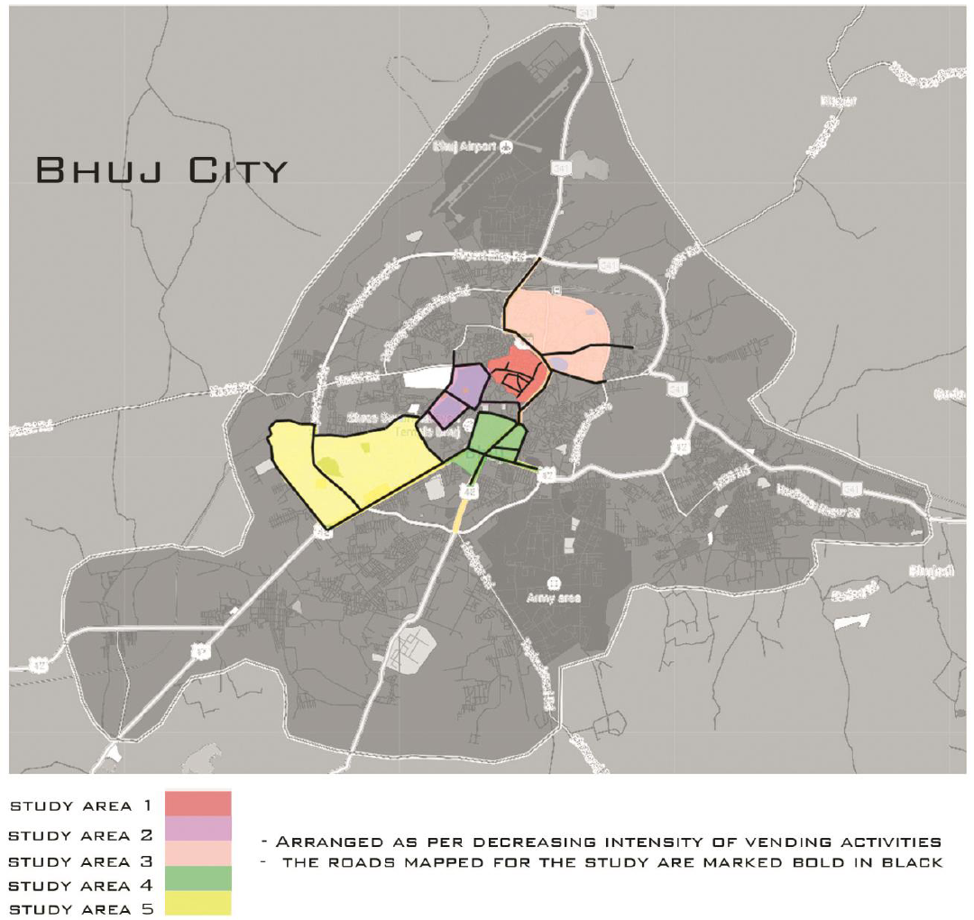
Recap- The City Level Reconnaissance
It is estimated that there are about 1,100 vendors in the city.
Annual turnover can be estimated to be about Rs 8.5 Crores.
Source: TISS, Mumbai

Slide 15
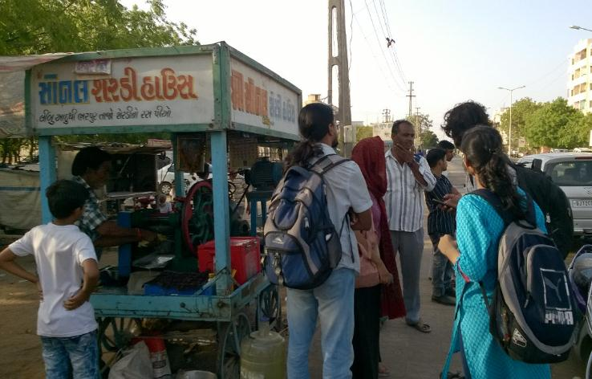
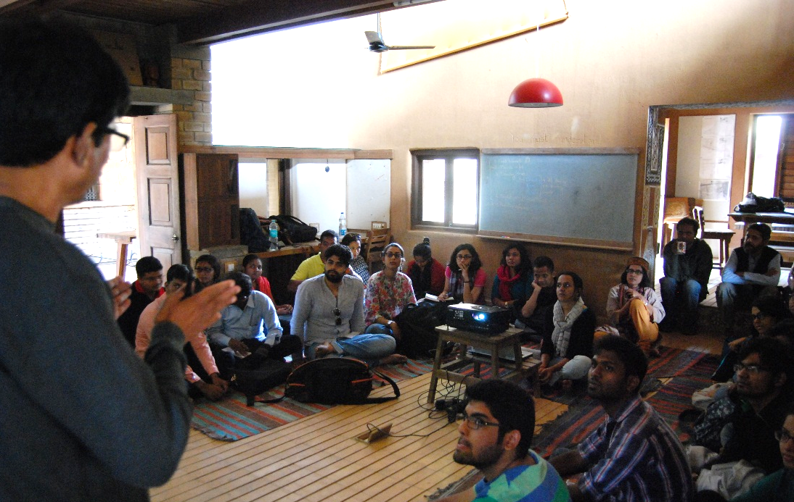
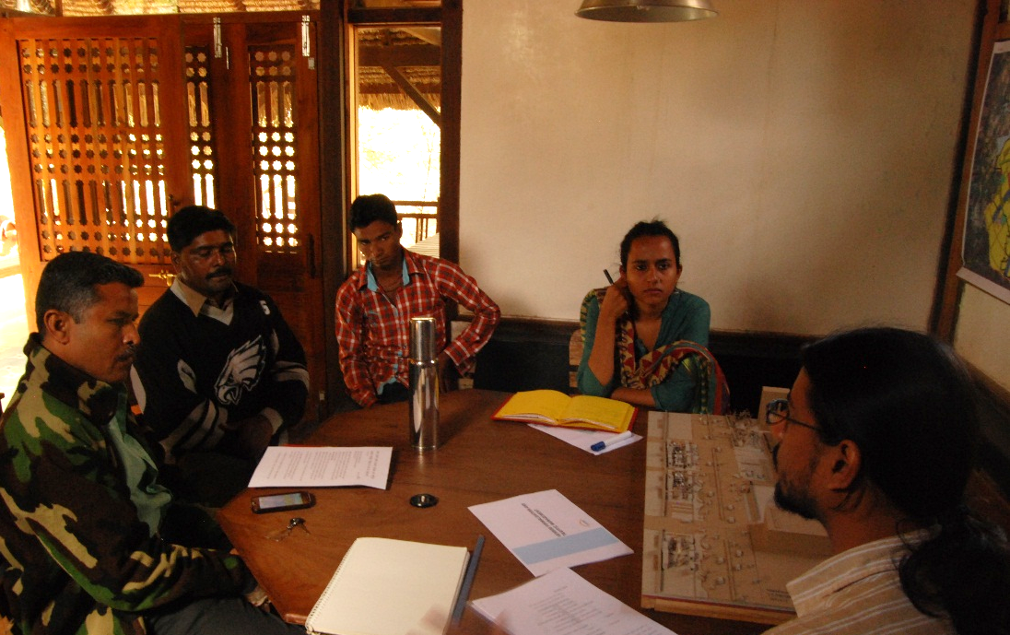
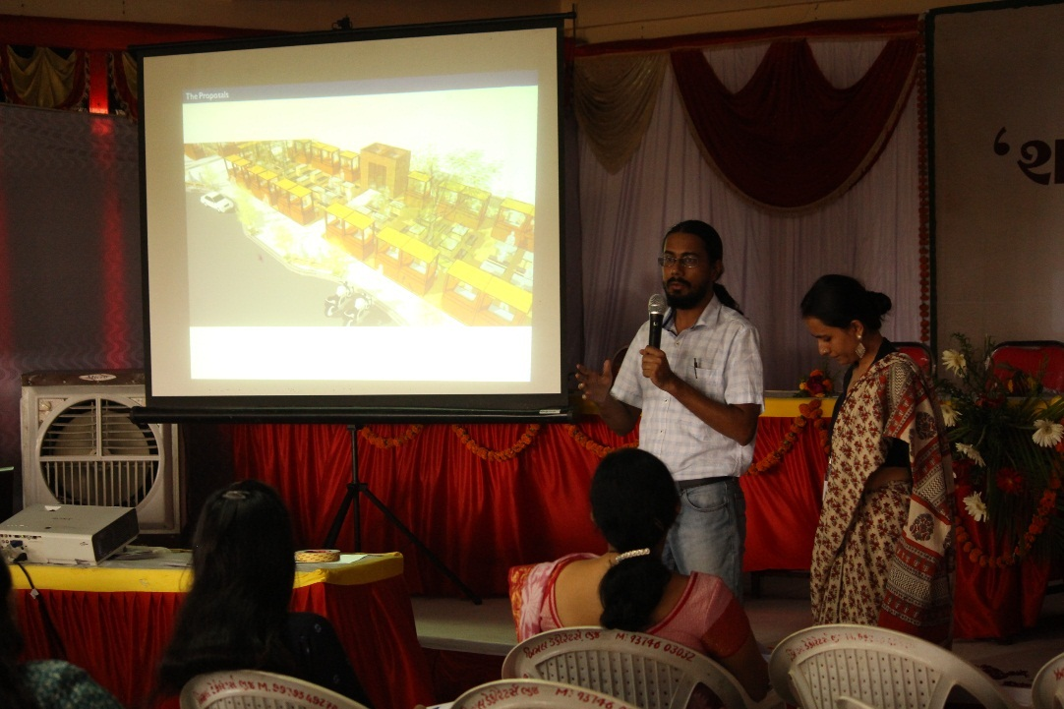
Recap- Discussions
Survey at Bhuj Haat site
Visit by students of TISS, Mumbai regarding vendors in the city
Discussion with representatives
Presentation of the work done in front of citizens

Slide 16
Recap- Financials
Sr. No. | Description | Monthly Remunerations | Duration of Fellowship | Unit | Cost | Total (Rs) | Exp. | Balance
1 | Salary of the Fellow (Aditya Singh) | Rs. 30,000.00 | 1 | year | Rs. 3,60,000 | Rs. 1,18,800 | Rs. 1,27,453 | Rs. -8,653
2 | Salary of Sub-Fellow (Bhawna Jaimini) | Rs. 18,000.00 | 1 | year | Rs. 2,16,000 | Rs. 71,280 | Rs. 63,000 | Rs. 8,280
3 | Program Cost | Rs. 5,000.00 | 1 | year | Rs. 60,000 | Rs. 19,800 | Rs. 1,535 | Rs. 18,265
4 | Experts Cost | Rs. 50,000.00 | 1 |  | Rs. 50,000 | Rs. 50,000 |  | Rs. 50,000
5 | Mentor Cost | Rs. 1,10,000.00 | 7 | days | Rs. 25,667 | Rs. 25,667 | Rs. 25,667 | Rs. -0
6 | Fellowship Cost |  |  |  |  | Rs. 2,85,547 | Rs. 2,17,655 | Rs. 67,892
7 | Coordination Cost |  |  |  |  | Rs. 99,941 | Rs. 75,680 | Rs. 24,261
8 | Administration Cost |  |  |  |  | Rs. 42,832 | Rs. 32,648 | Rs. 10,184
 |  |  |  | GRAND TOTAL : |  | Rs. 4,28,320 | Rs. 3,25,983 | Rs. 1,02,337

Slide 17
EXTENSION OF THE FELLOWSHIP

Slide 18
Extension- Vision and Objectives
VISION
Set up a mechanism for provision of social and economic security to the vendors of Bhuj city by linking them to basic infrastructure and services.
OBJECTIVE
To address the vulnerabilities of the urban street vendors through a multi-pronged approach.

Slide 19
Extension- Introduction and Need
xxx

Slide 20
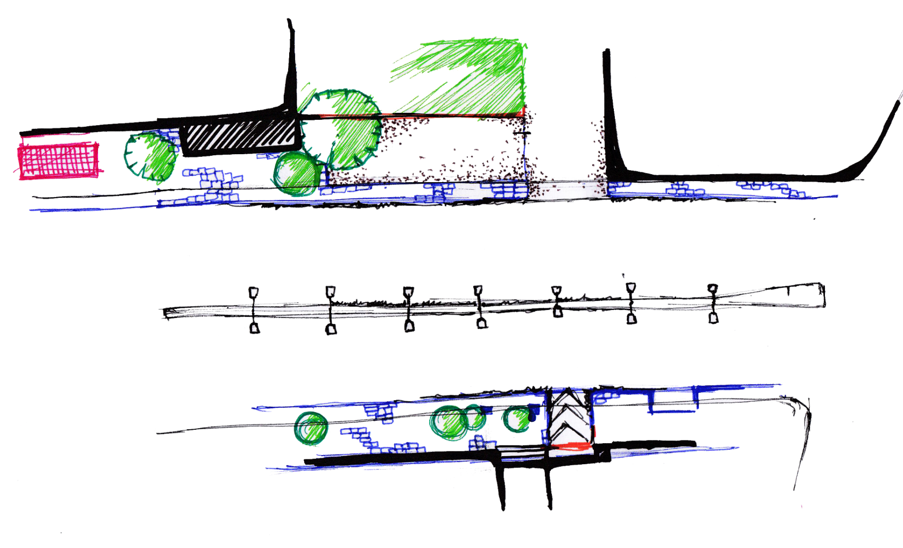
Extension- Development of Mapping Techniques
JUBILEE GROUND

Slide 21
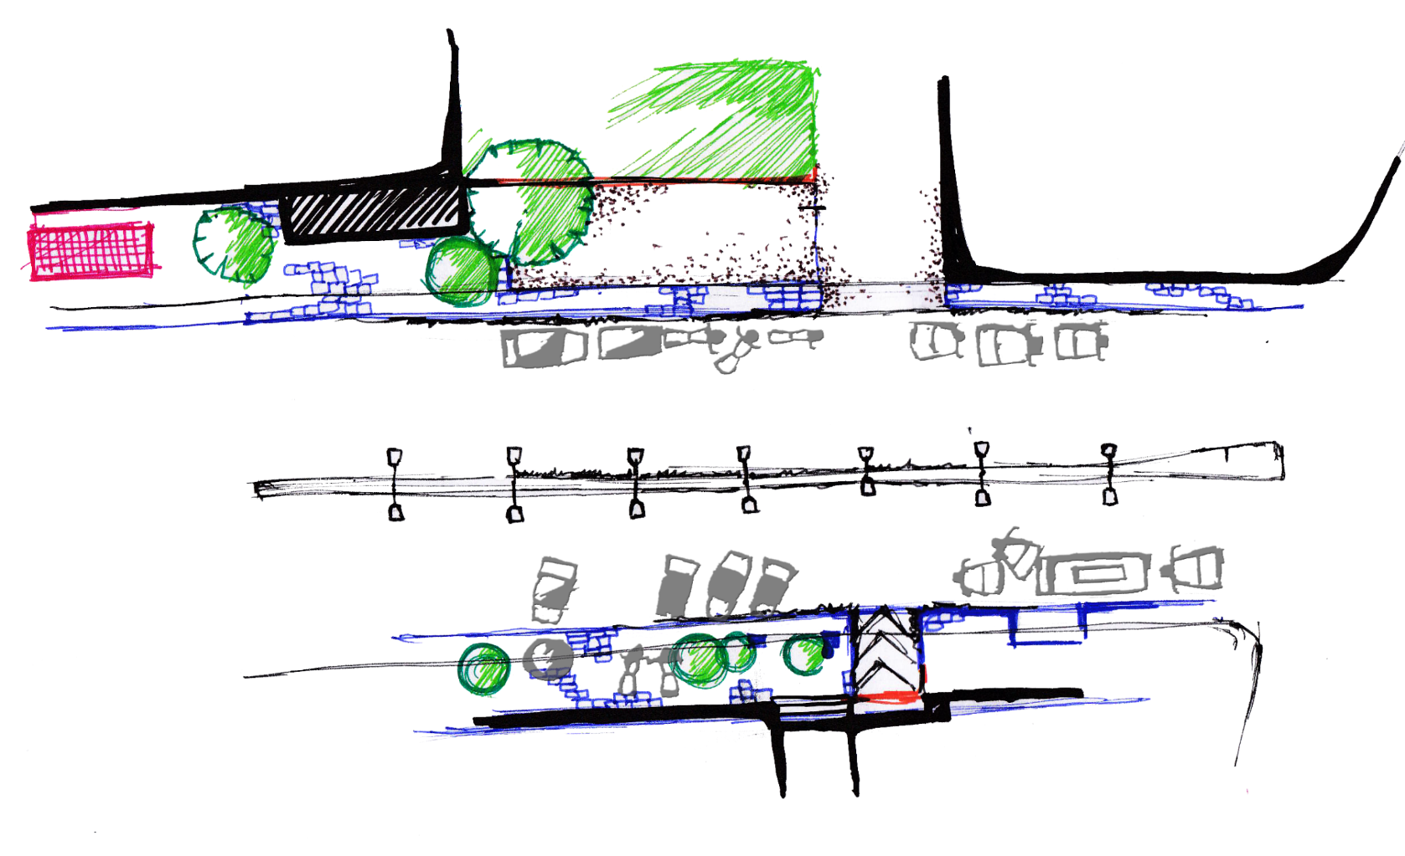
Extension- Development of Mapping Techniques
JUBILEE GROUND

Slide 22
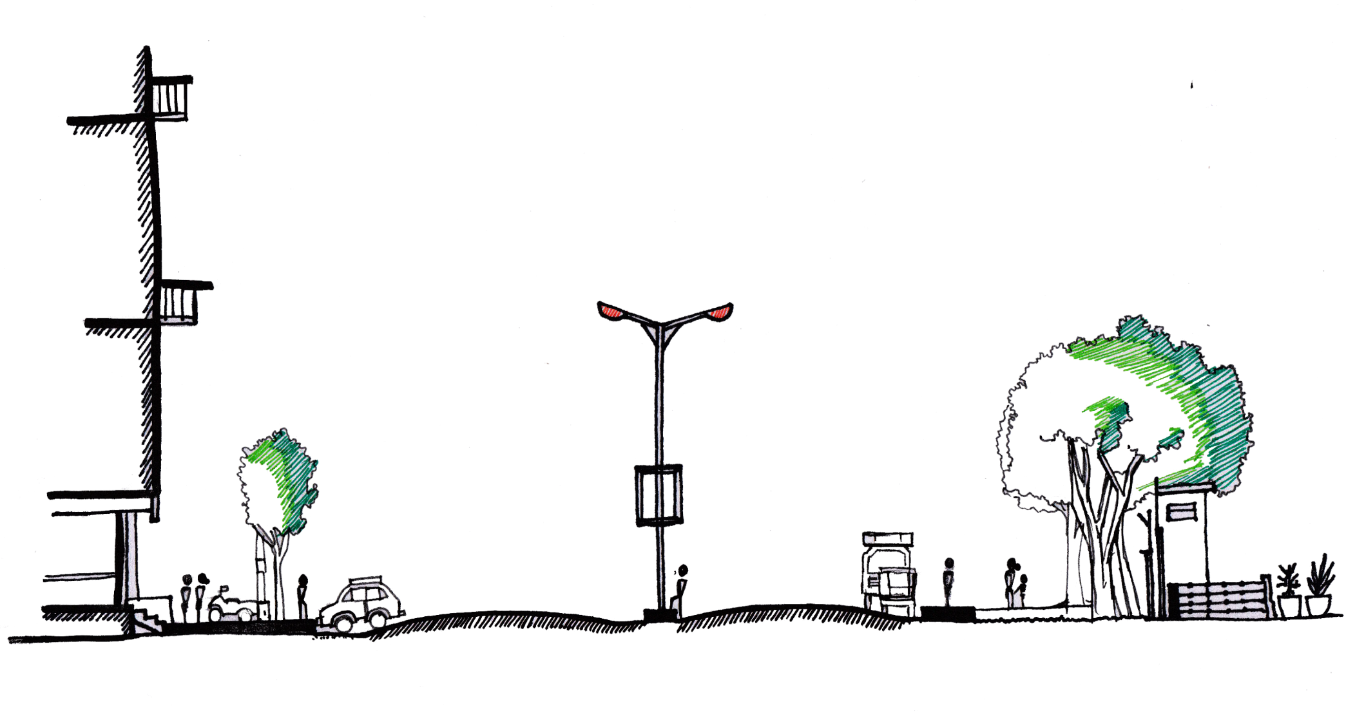
Extension- Development of Mapping Techniques
2-W
JUBILEE GROUND
2-W
3-W
4-W
4-W
Pedestrian
3-W
Pedestrian
Bus
Bus
2016-17
2015-16
2016-17
2015-16
MORNING
EVENING

Slide 23
Pictures’ Source: Students of TISS

